Slide 1
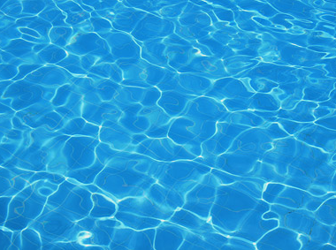
H20 Wars
To stop the shortage of water,
we must use MORE water!

Slide 2

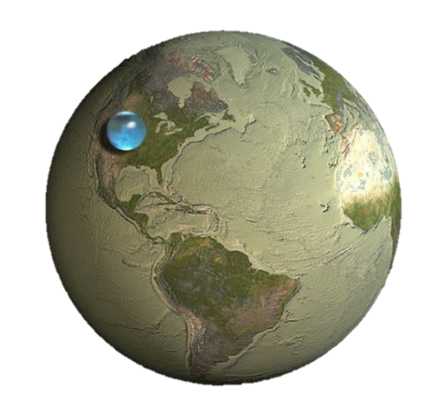
H20 Wars: Story
There’s a shortage of Water on Planet Earth!

Slide 3
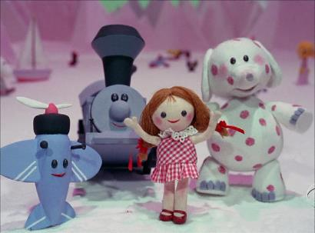

H20 Wars: Two Factions
Free Water Warriors
Ragtag group of misfits who want to claim the water for “the people”
Alliance for Water Equality (AWE)
Wants to control the water for fair distribution

Slide 4

H20 Wars: Two Factions
Free Water Warriors
Ragtag group of misfits who want to claim the water for “the people”
Alliance for Water Equality (AWE)
Wants to control the water for fair distribution

Slide 5

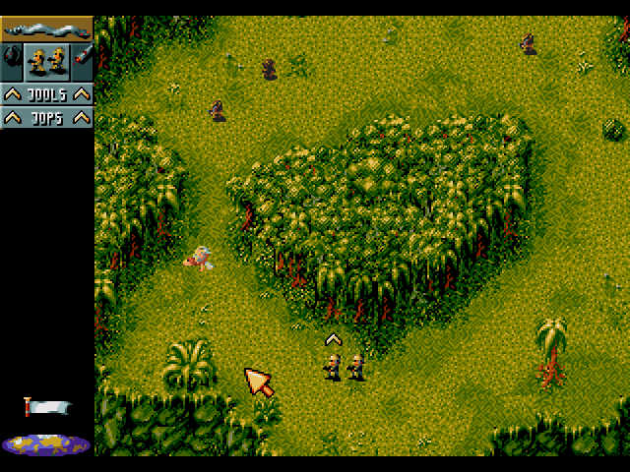
H20 Wars: Description
Top-Down Shooter with Water Guns and Water Balloons
Think updated
Cannon Fodder

Slide 6
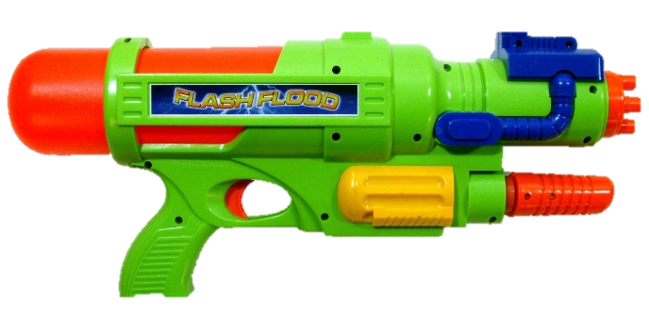


H20 Wars: Premise
Top-Down Shooter with Water Guns and Water Balloons
Think updated
Cannon Fodder
with
Water
Guns!

Slide 7

H20 Wars: Character Health
The Wet Bar
When it fills up, you are SOAKED (ie DEAD)
Characters dry off in time
Most characters easily SOAKED.

Slide 8
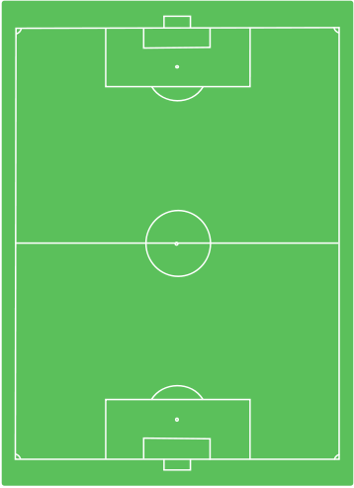







H20 Wars: Gameplay
Squad
X
1 troop
Move
to
Attack!
6 troops
Limited Ammo

Slide 9

H20 Wars: Water
Water is Ammo
Water is Health
Water is Points
Water is POWER!

Slide 10
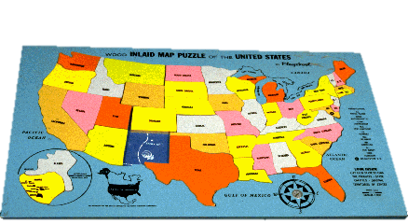
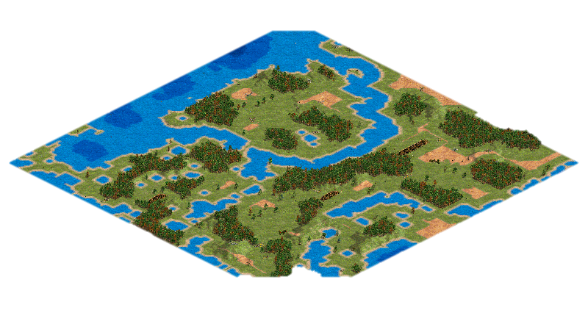
H20 Wars: Maps
Campaign – Puzzle/Action Driven Maps that drive the Story.
Skirmish – Procedurally Generated Maps that are fair for all sides

Slide 11
H20 Wars: Possible Modes
Story Mode
Deathmatch
Water Bottle Grab (Capture the Flag)
Won’t Someone Think of the Children (similar to C.S. Hostages)
This Land is my Land (Capture the Point)

Slide 12
H20 Wars: Why?
Simple, exciting, interactive gameplay
Quick Rounds for the Casual Gamers
Light theme, with lessons in…
Teamwork
Solving the Problem may create the Problem
Never Giving Up

